Slide 1
Naan mudhalvan data science project
PROJECT TITLE:
NATURAL GAS USAGE
PRESENTED BY:
A.PANNEER SELVAM
REG.NO:912321105019
SACS MAVMM ENGINEERING COLLEGE
III YEAR EEE DEPT

Slide 2
Project statement
Electricity. We can generate electricity with natural gas – with steam turbines and gas turbines. ...
Heating. ...
Transportation & production (industrial use) ...
Uses of natural gas. ...
Cooking. ...
Water heating. ...
Air conditioning. ...
Lighting a fire.

Slide 3
Abstract
Energy is gaining great prominence and priority regarding improvement the level of prosperity by completing the economic development of countries. Natural gas is becoming one of the most important energy sources in the world because of the low level of greenhouse gas emissions resulting from the burning of natural gas. For that reason, natural gas consumption is increasing rapidly in the world. Natural gas, which is the main raw material of various chemical products, meets a significant part of the world energy consumption

Slide 4
INTRODUCTION
Energy is a factor that cannot be ignored in the social and economic development of countries and, therefore, in increasing social welfare, continues to be a considerable issue in all parts of the world. It is extremely noteworthy to obtain energy from continuous, cheap, reliable and clean sources and to utilize it efficiently.
Natural gas is a gas in the fossil-derived gas class which consists of methane gas in large quantities, under the pressure and temperature transformation between the ground layers of the living things of our world living millions of years ago

Slide 5
World natural gas productioN
World natural gas production, which was 3463.2 bcm in 2014, increased by 2.2% (3538.6 bcm) in 2015. While natural gas production dropped by 1.5 % in Russian Federation, it rose by 5.4 % in the US, 16.4 % in Myanmar and 5.7 % in Iran. The United States proceeded to be the world's largest natural gas producer with 763.7 bcm. The regions that have the highest increment in natural gas production in 2015 are the Middle East (45.2 %), Asia Pacific (22.6 %) and North America (21.3) [5]. Top 10 countries having the highest total of share in these regions.

Slide 6
World natural gas reserve lifetime
The natural gas production went down due to the economic crisis experienced in 2009. For that reason, natural gas reserve life increased and the reserve life of 2009 become 62.7 year. Reserves-to-production (R/P) ratios are calculated with the total current reserve (186.9 tcm) divided by the total current production (3.538 tcm); thus, the global reserve life was estimated to be 52.8 years. It is predicted that the US, which has the highest share in world natural gas production, has a reserve life of less than 20 years

Slide 7
World natural gas consumptioN
From 1965 to 2015, the use of fossil fuels sustained to grow remarkably and share of energy supply enhanced. Since then, natural gas has been adopted by regions and found itself an important place among fossil fuels even though the consumption quantities have decreased from time to time. The constant increase in natural gas consumption between 2005 and 2008 was followed by a steady increase in the following years after a decline in 2009. Provided that the economic crisis which took place in 2009 is ignored, world natural gas consumption increased by 4.7 % (3051.2 to 3201.4 bcm) when compared to 2008 and 2010 natural gas consumption.
Asia Pacific (20.1 %), North America (28.1 %) and Europe & Eurasia (28.8 %) are regions which witnessed the highest increase in consumption in 2015. From the beginning of 2009 until 2015, natural gas consumption in the US, which is the world's largest natural gas consumer, increased by 20 % (129.3 bcm) whereas natural gas consumption in Russian Federation, which is the world's second largest natural gas consumer, rose nearly by 0.5 % (1.9 bcm). Although consumption in the Europea & Eurasia region, which also includes Turkey, increased by 10 % (3.3 bcm) in 2010 compared to 2009, this consumption amount in 2015 was observed to be lower than consumption amount in 2014. From the beginning of 1965 onwards, natural gas consumption amounts by years are illustrated

Slide 8
Effects of natural gas on air pollution
In all cities of the world, fossil-based energy sources are being used extensively, either directly or by converting to electricity, in the face of the majority of energy needs. The production and use of fossil-derived energy brings many negative effects on human and environmental health. Air pollution caused by burning varies depending on the amount of fuel burned, the fuel pollution and combustion characteristics, combustion systems and operating conditions, pollutant emissions to atmosphere, and topographic and meteorological conditions.

Slide 9
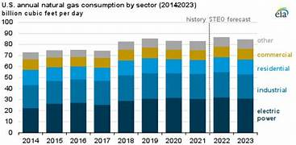

Slide 10
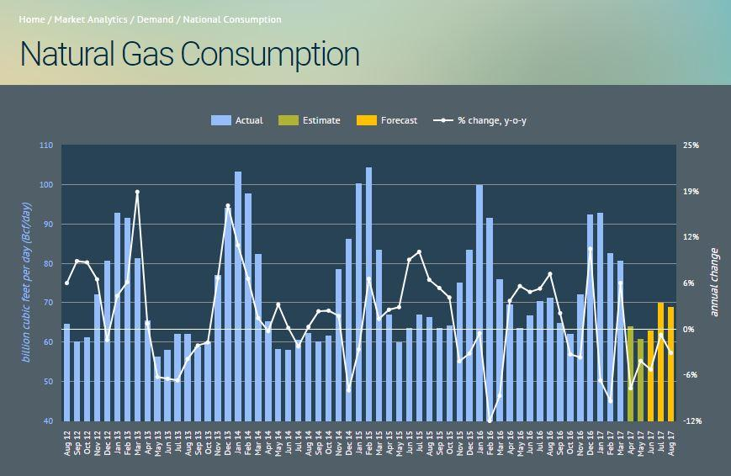

Slide 11
THANK YOU

